Slide 1
ENSE 470: Milestone 4
Team Dancing to Zebras
Tristan Heisler, Demitri Kourles and Zuoxiu Xing
March 1st, 2018

Slide 2
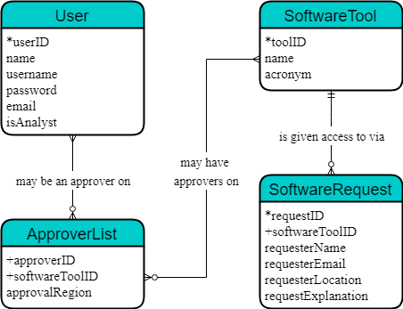
Database Snapshot

Slide 3
Database Snapshot
Database and schema
We chose to use MySQL as our database implementation.
This implementation allows us to much more easily update and retrieve information relevant to our software.
Experience in cleansing the data
Cleansing began by separately identifying and entering information about the approvers and the tools.
The user and tool ids were then used to easily develop cleansed approver list.
We were initially unsure how to handle the tool with approvers varying by region (myeHealth). We decided to include a “approvalRegion” column which defaults to nation-wide.
Abbreviations were not adjusted from the given values as this could potentially confuse users familiar with the existing system.

Slide 4
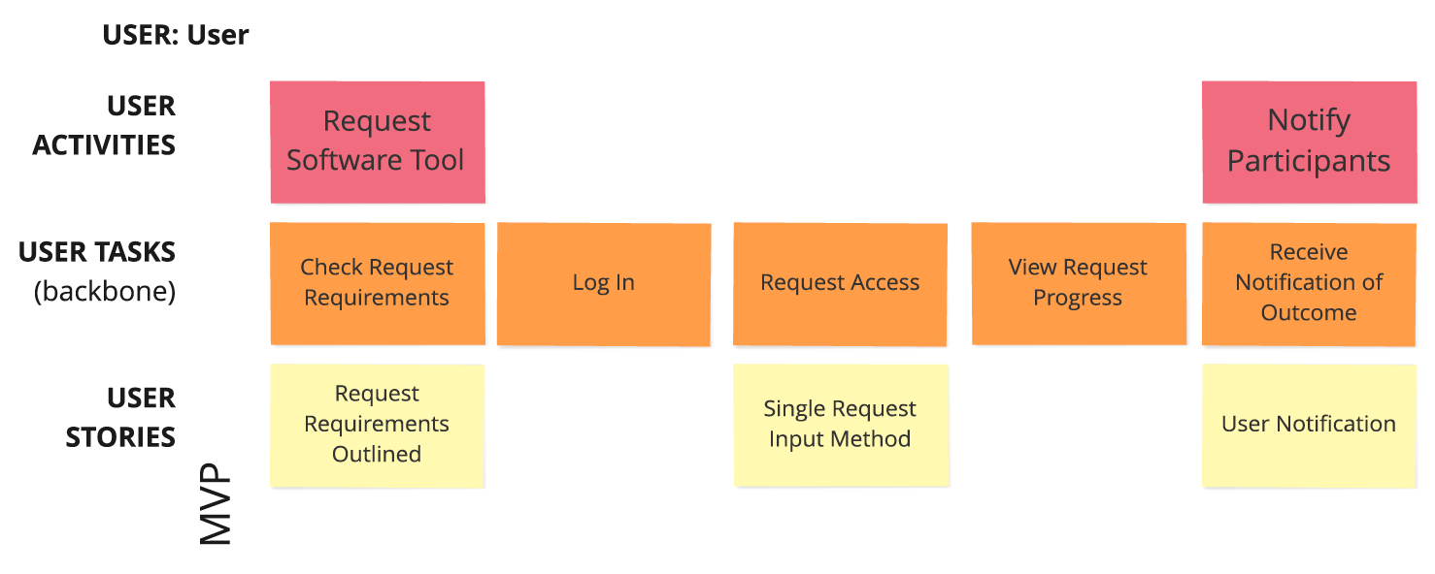

Slide 5
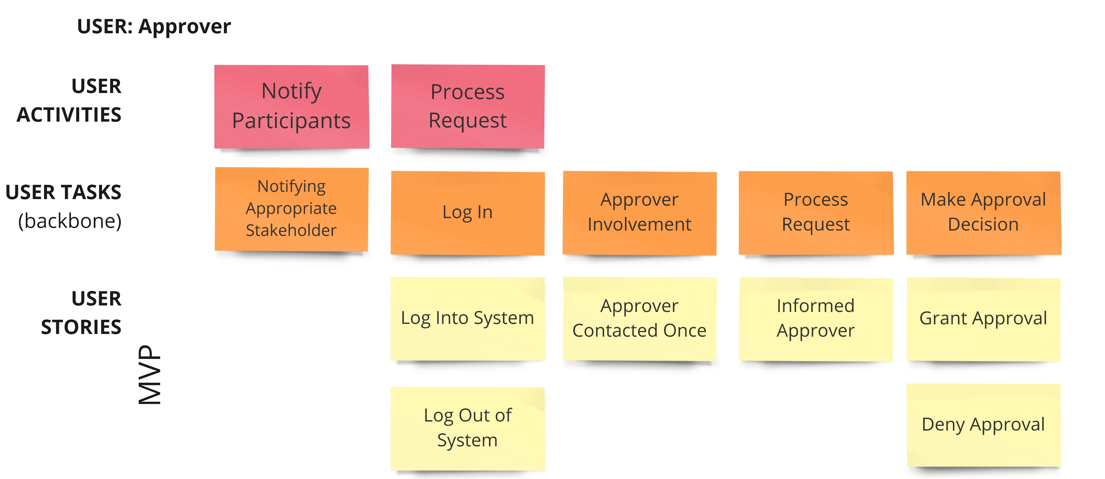

Slide 6
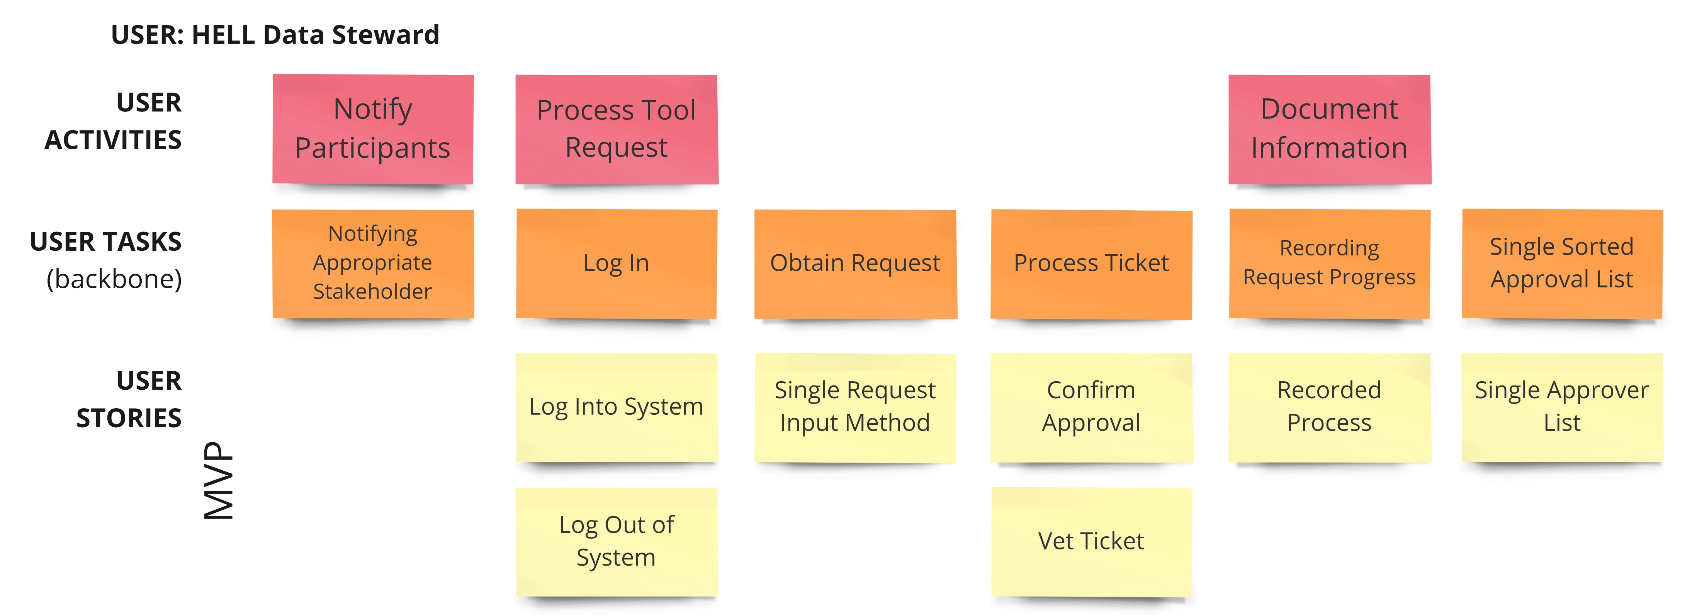

Slide 7
Lo-Fidelity Prototype Experience
We used pencil and paper to develop our lo-fidelity prototype.
Pros:
It allowed easily reuse and modification of components.
A model of the system could be created with minimal upfront costs.
Cons:
The appearance of the model is not as appealing as other possible methods.
Some interface design choices and message flows used in the model may be more difficult to truly implement.

Slide 8
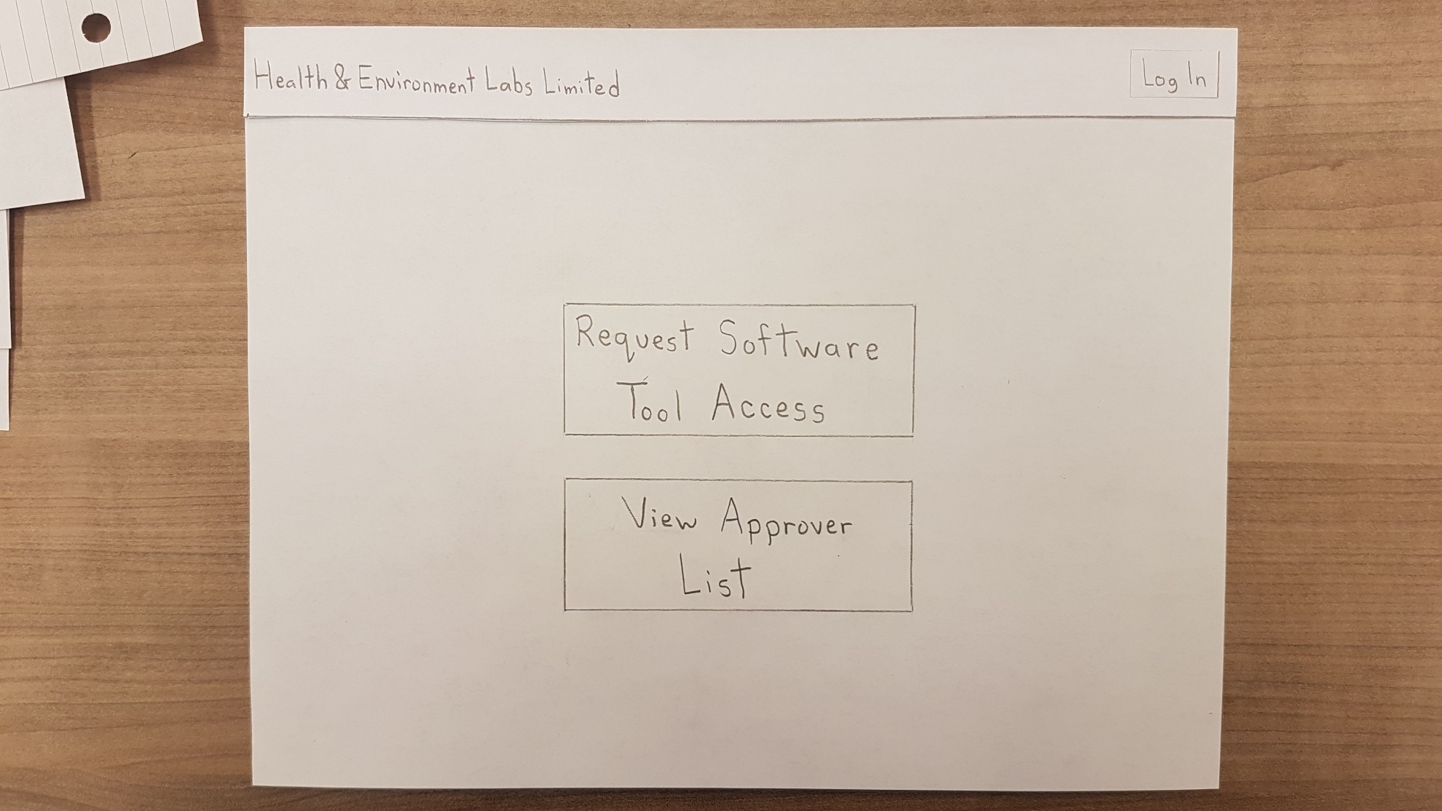

Slide 9
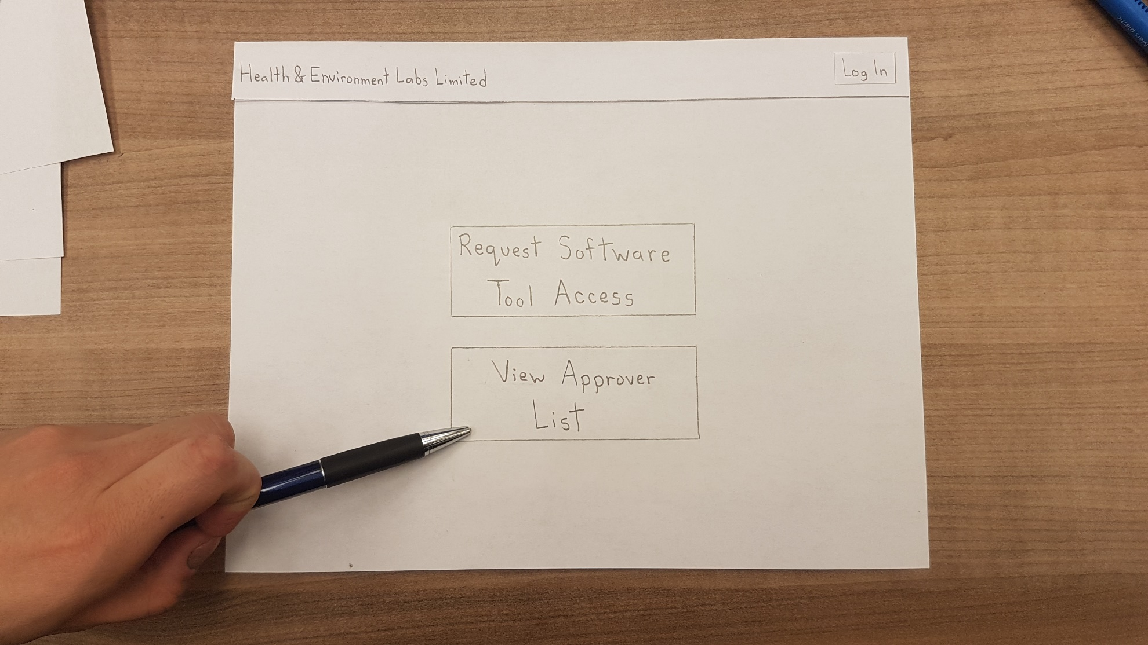

Slide 10
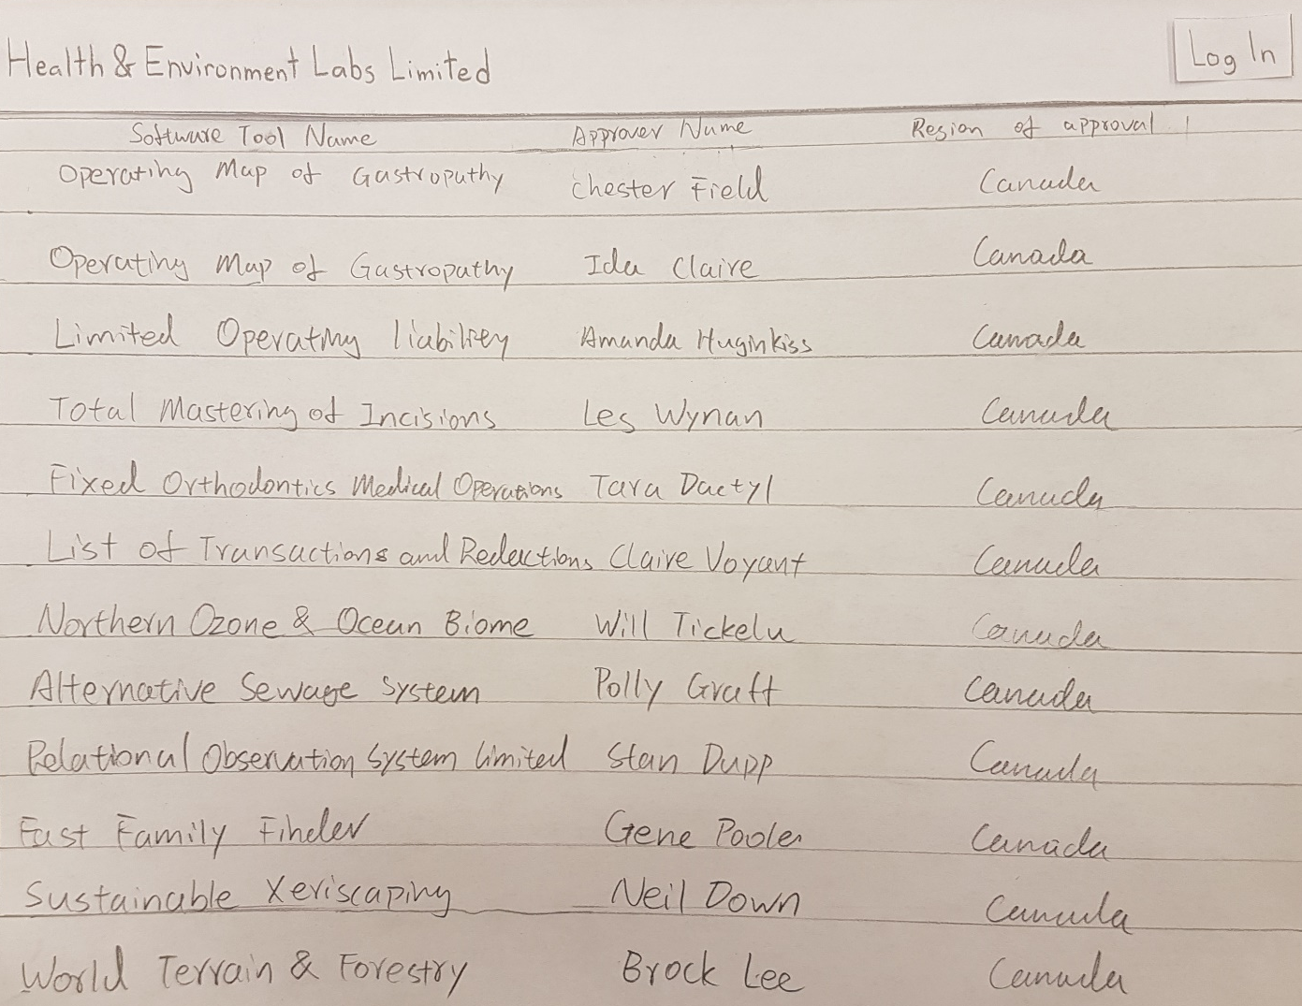

Slide 11
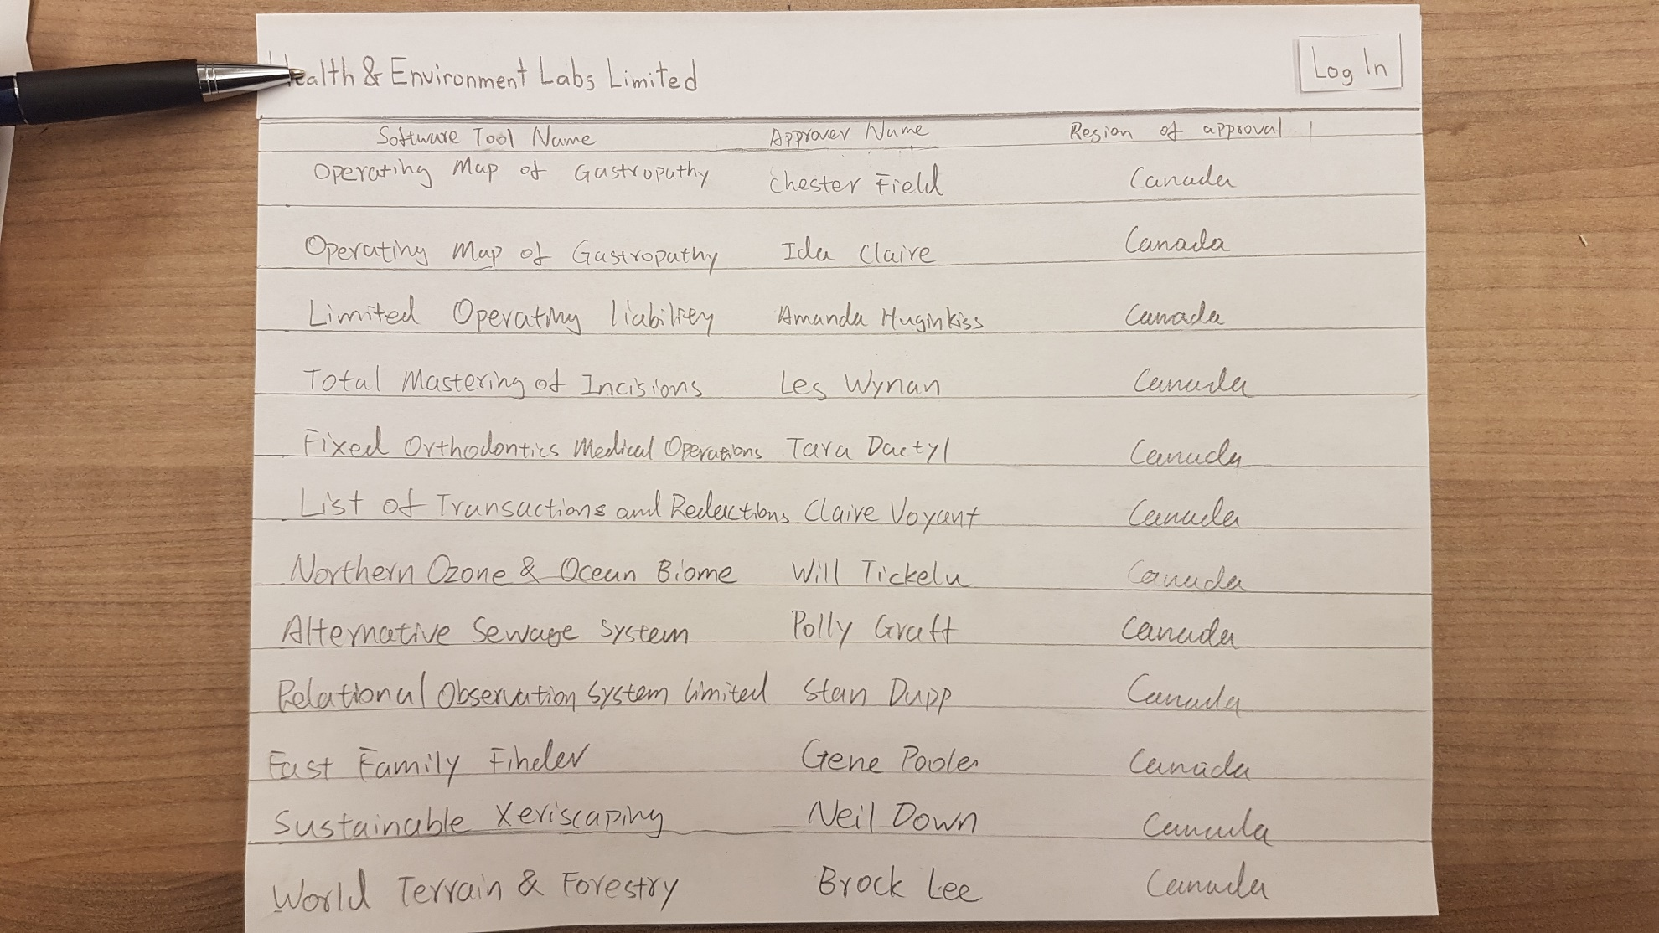

Slide 12
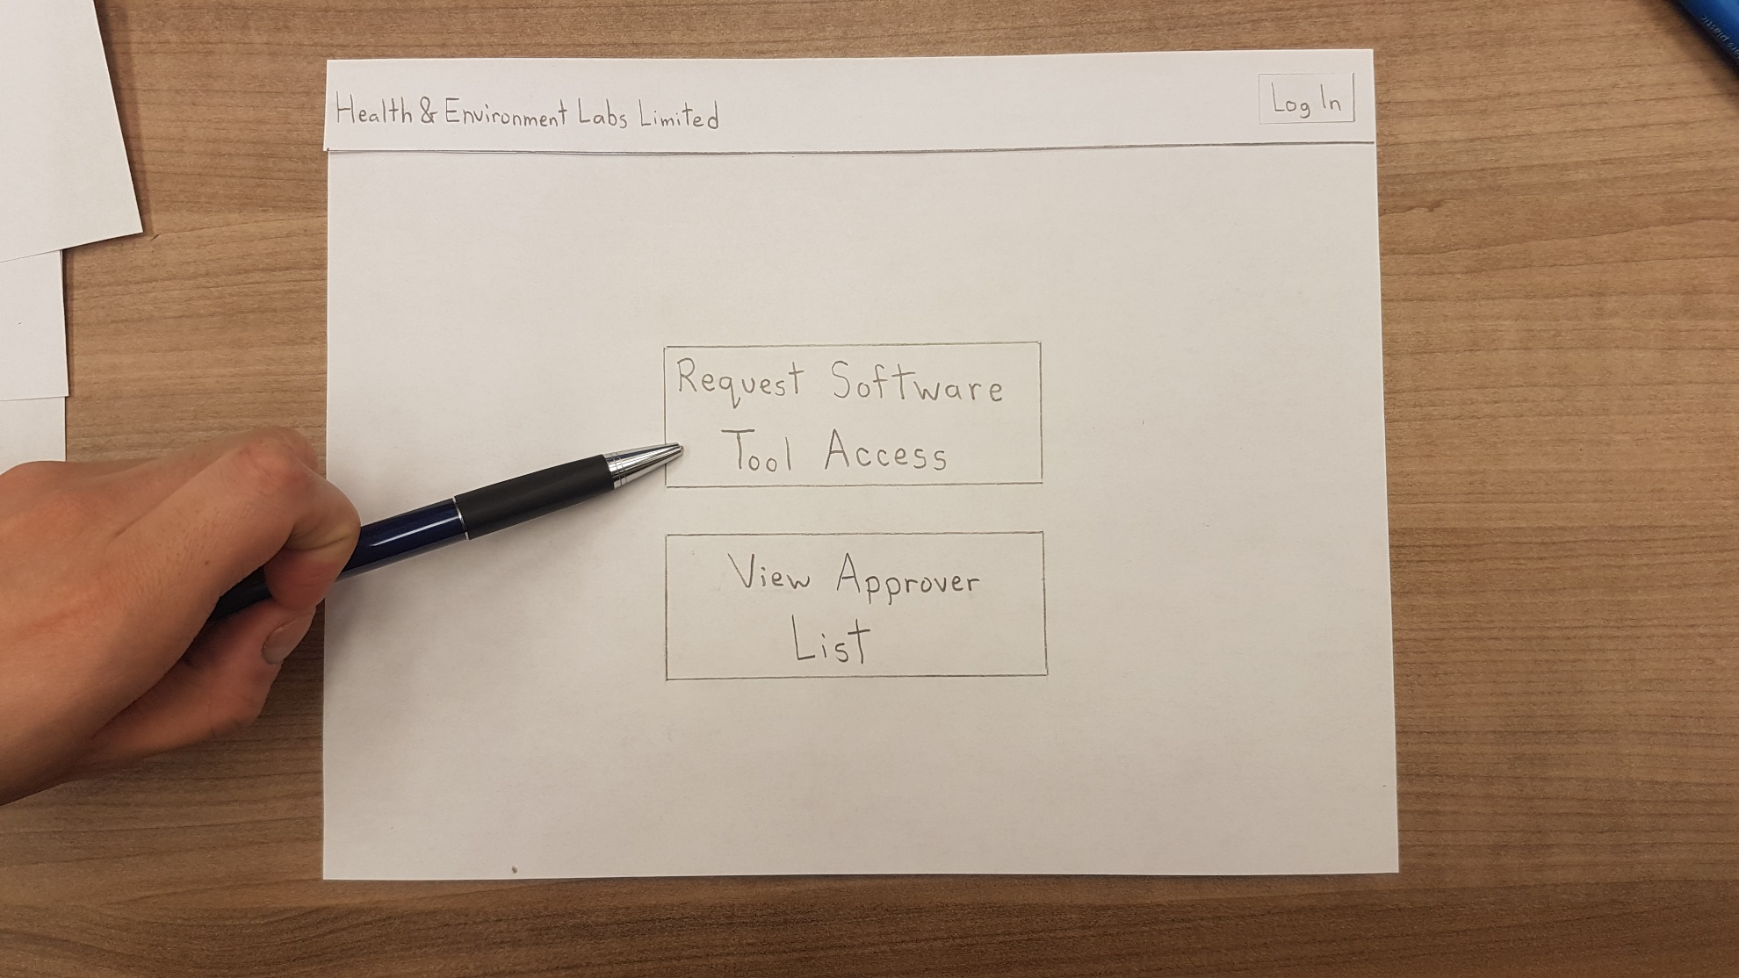

Slide 13
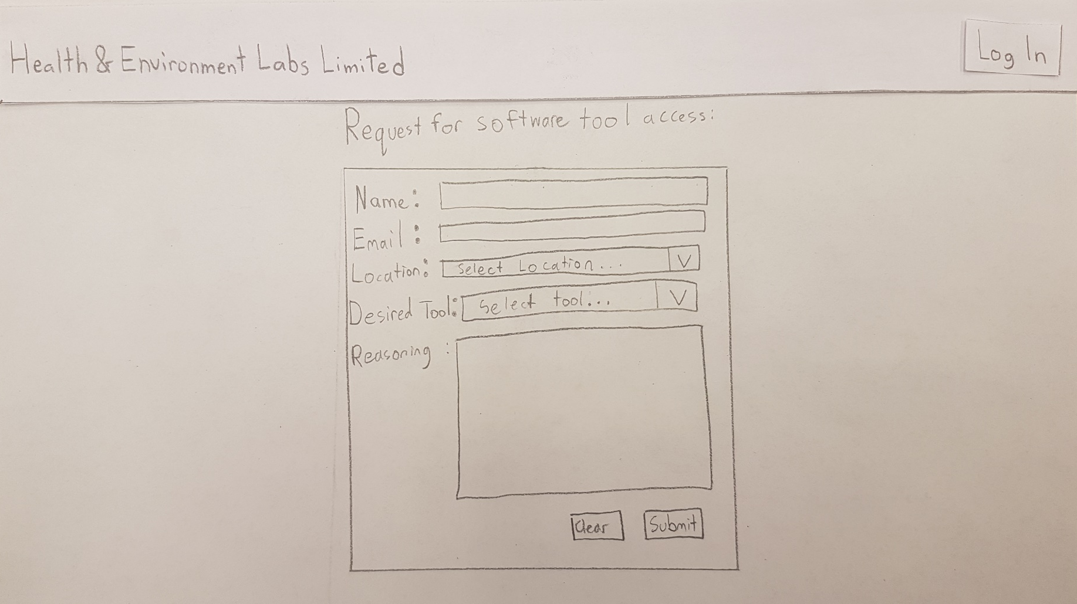

Slide 14
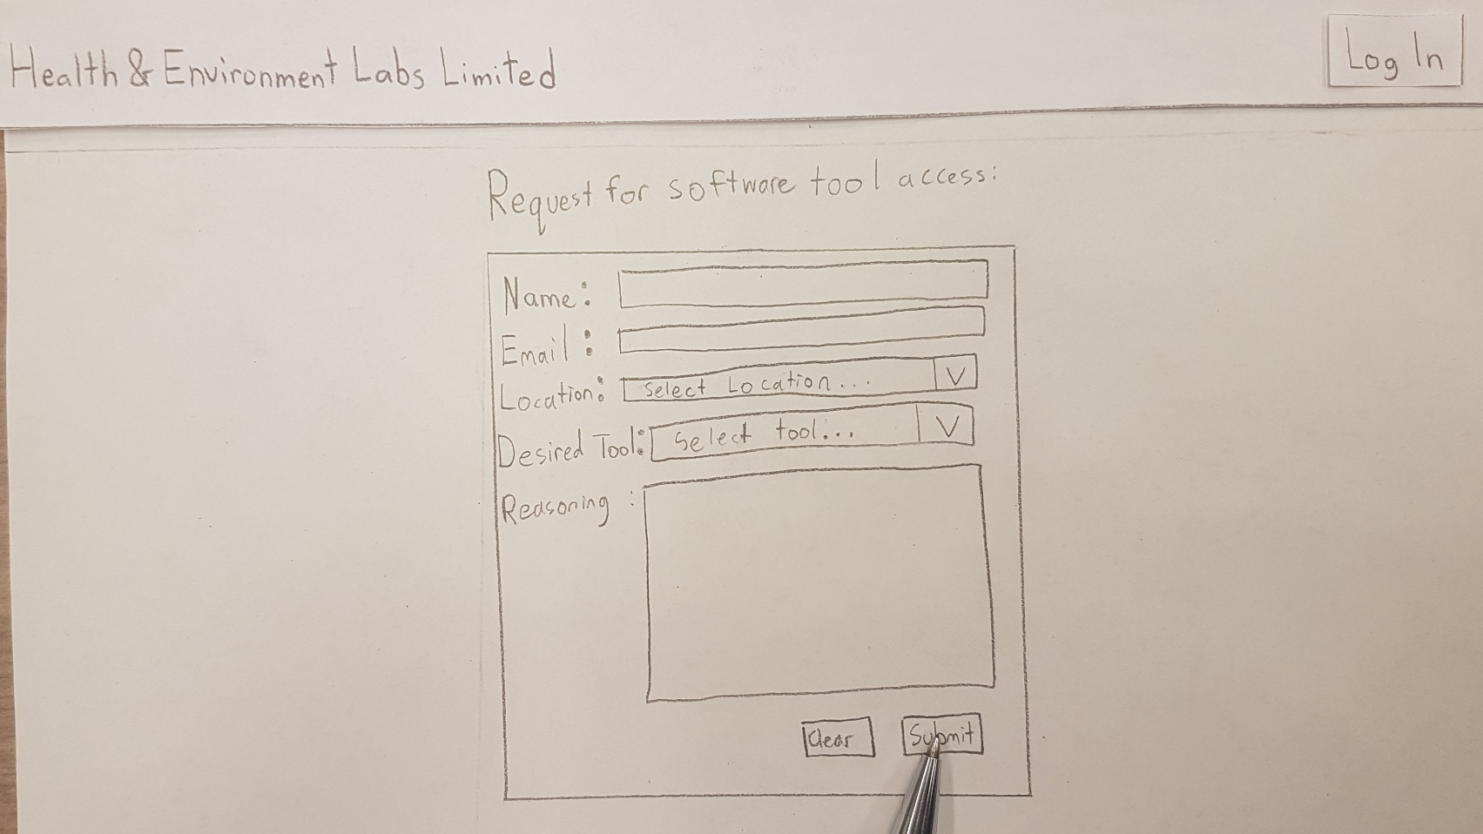

Slide 15
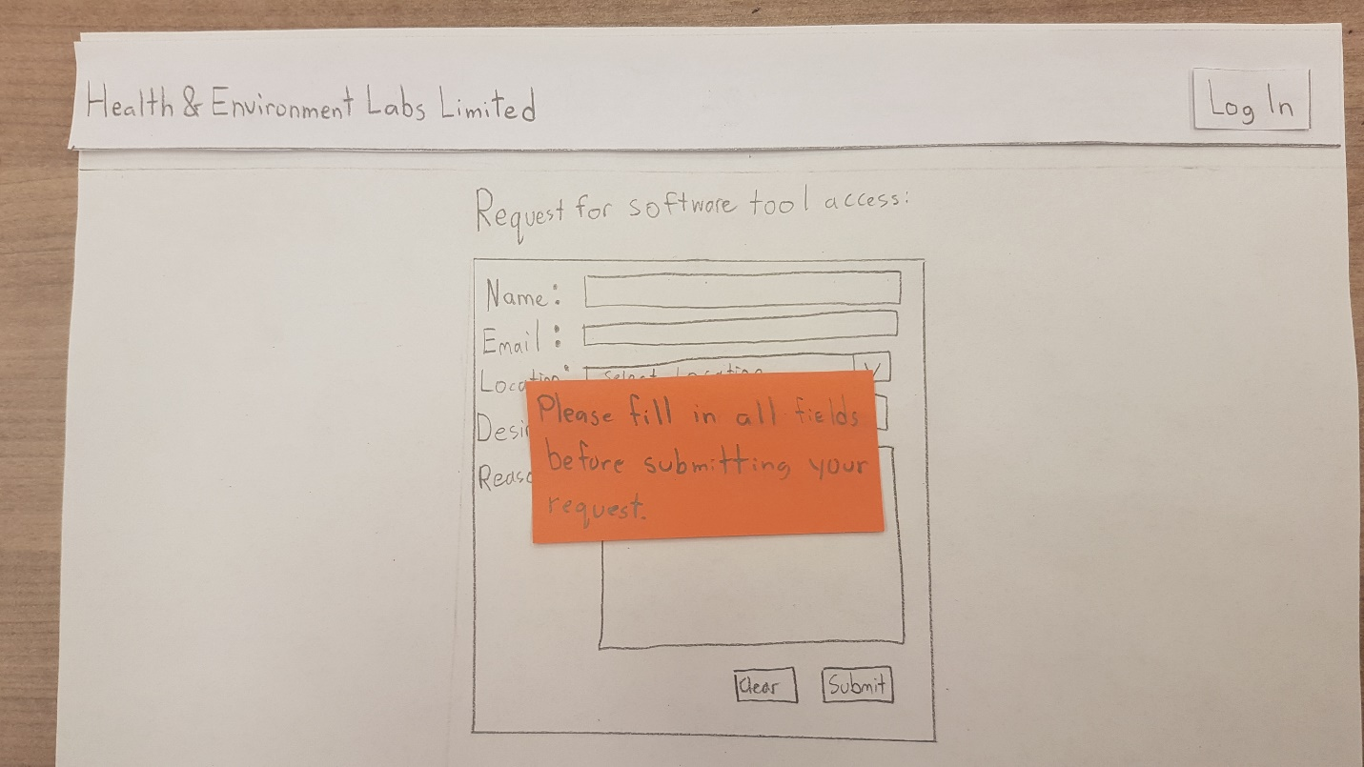

Slide 16
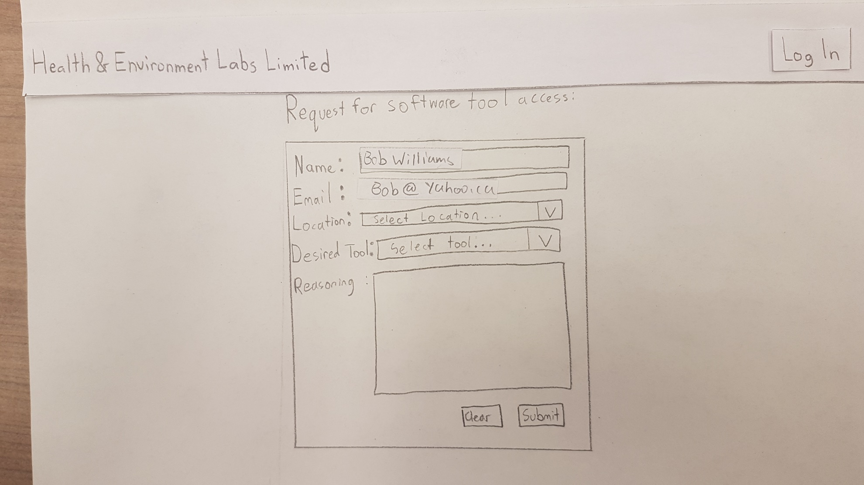

Slide 17
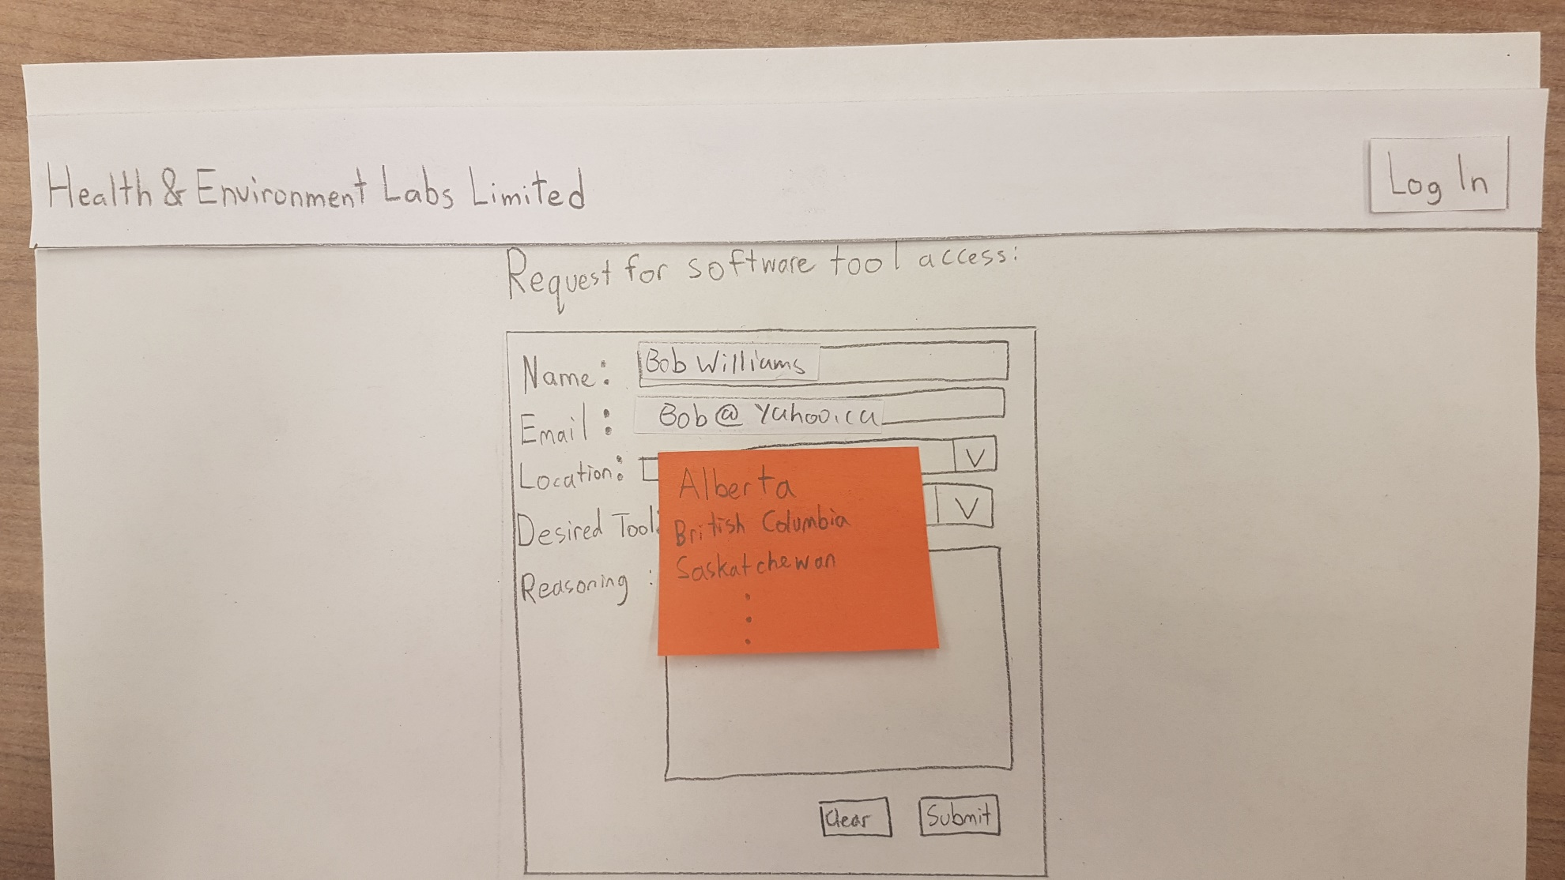

Slide 18
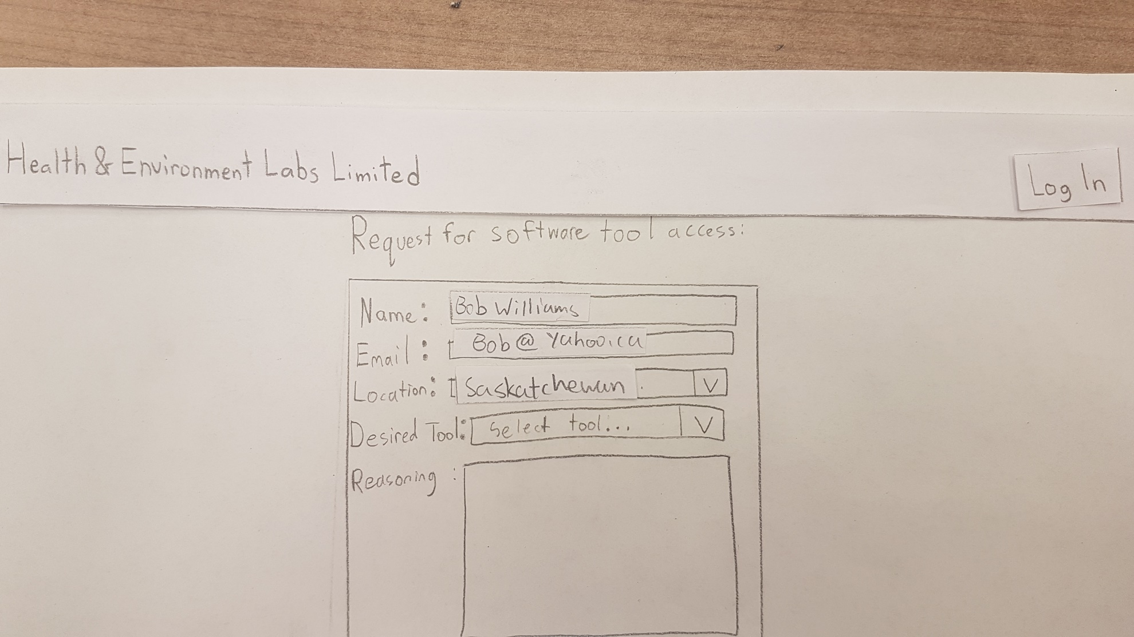

Slide 19
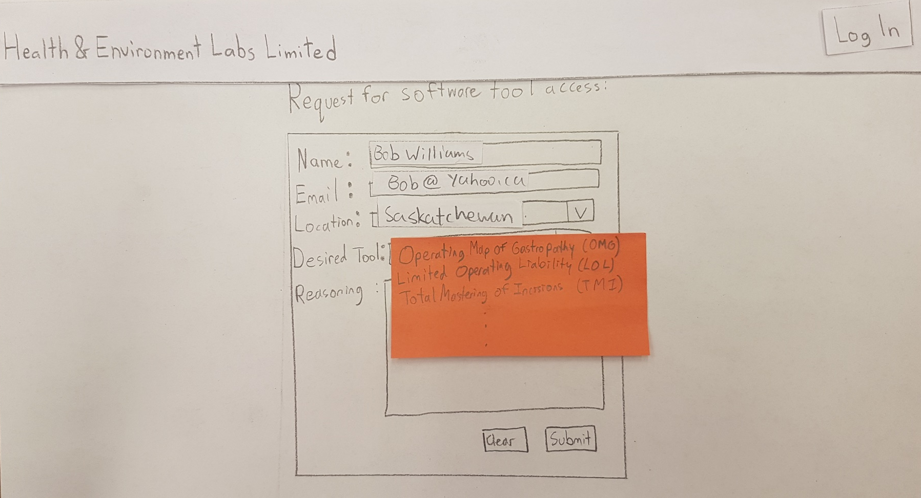

Slide 20
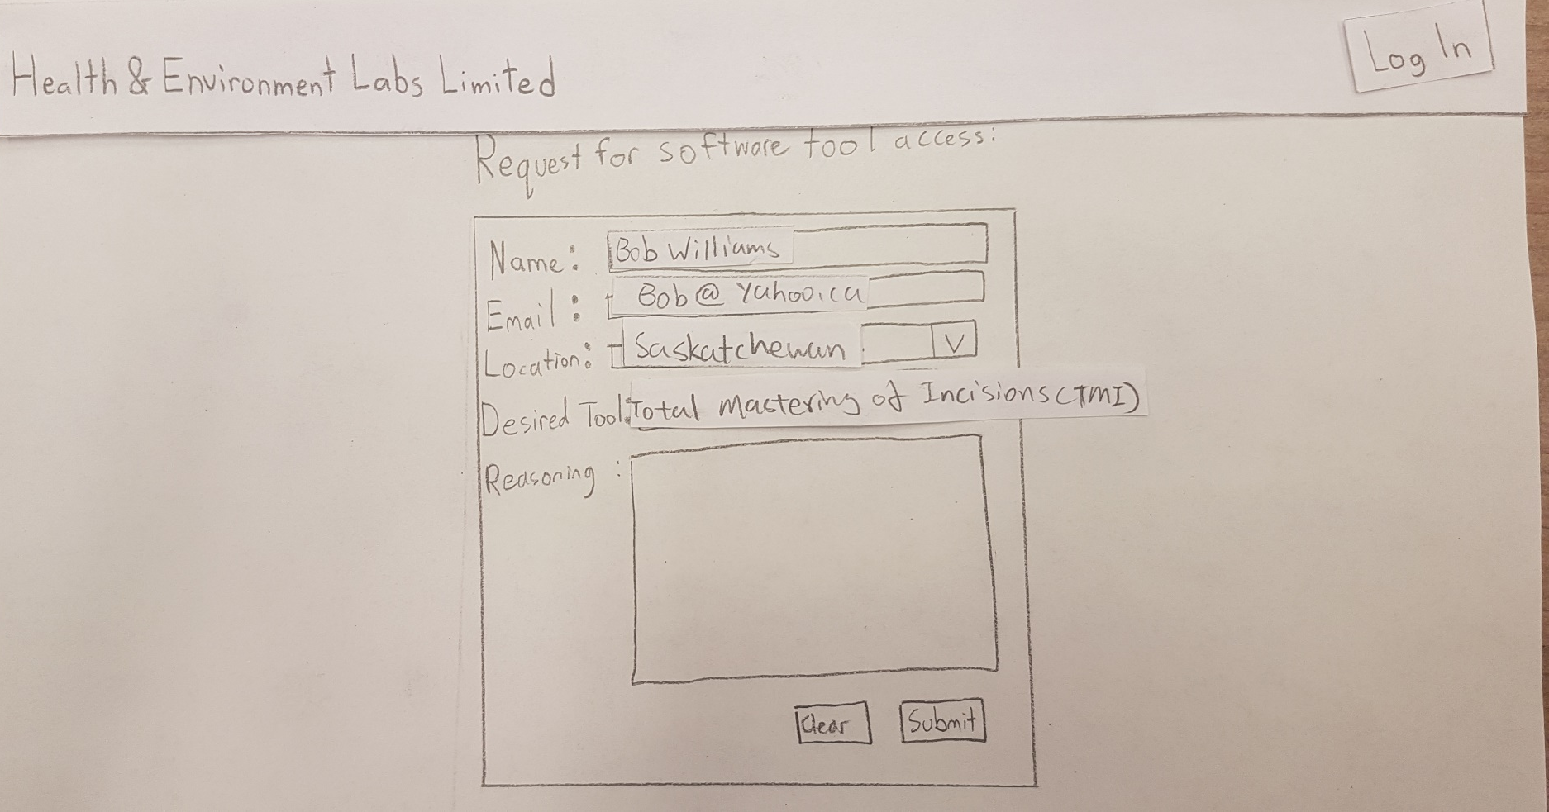

Slide 21
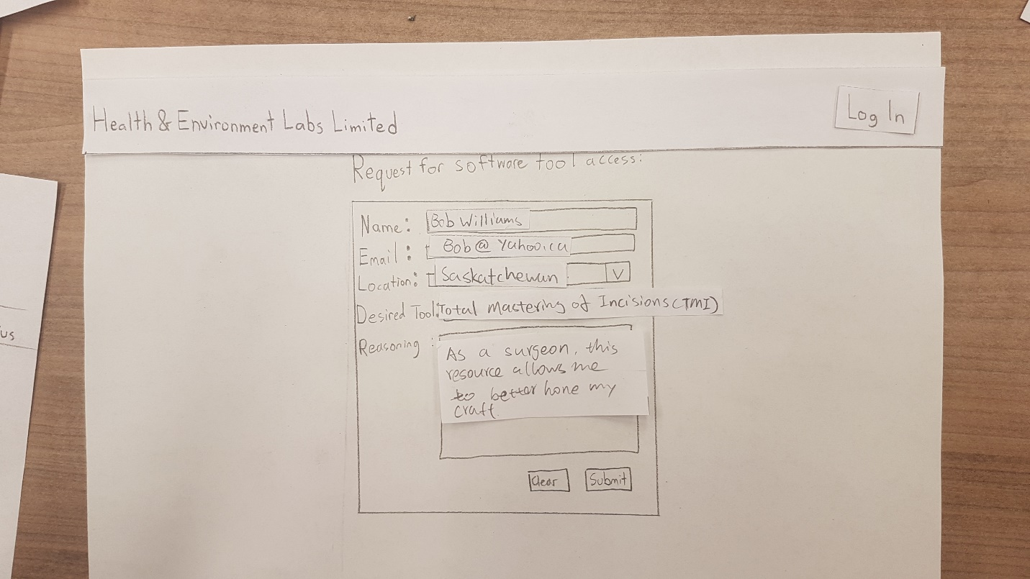

Slide 22
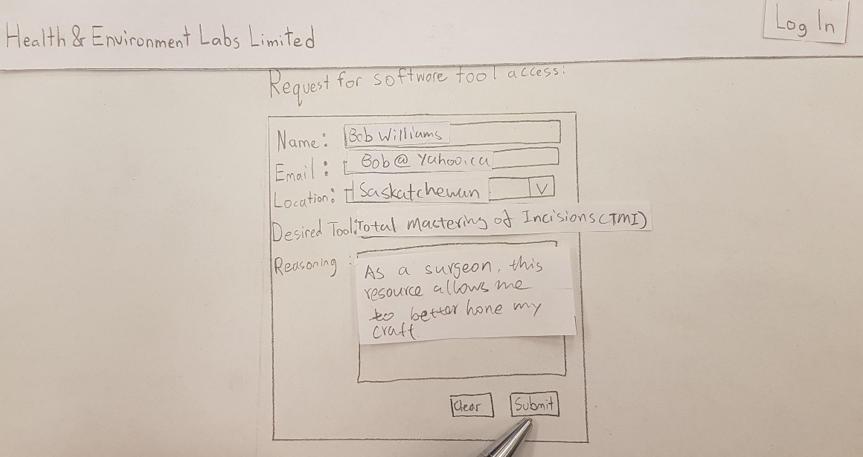

Slide 23
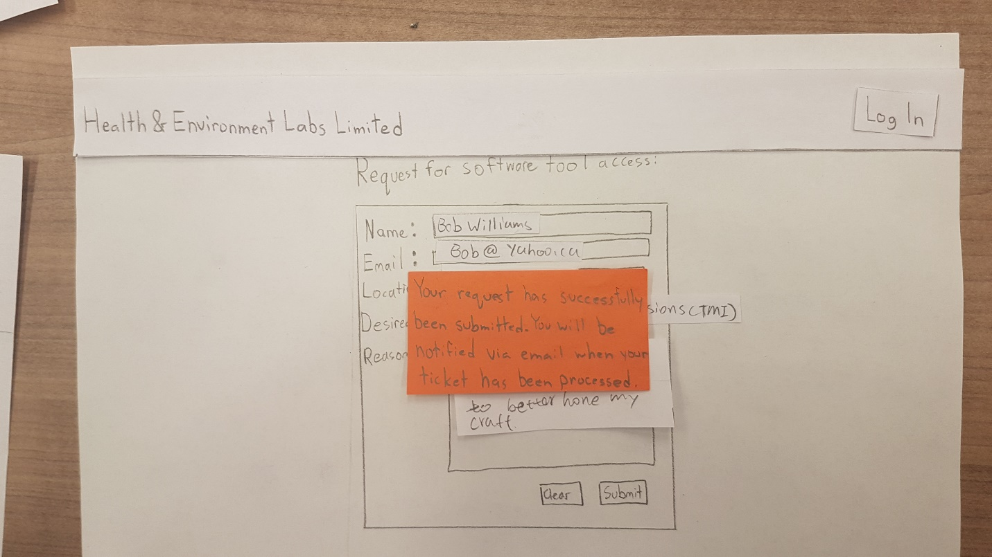

Slide 24
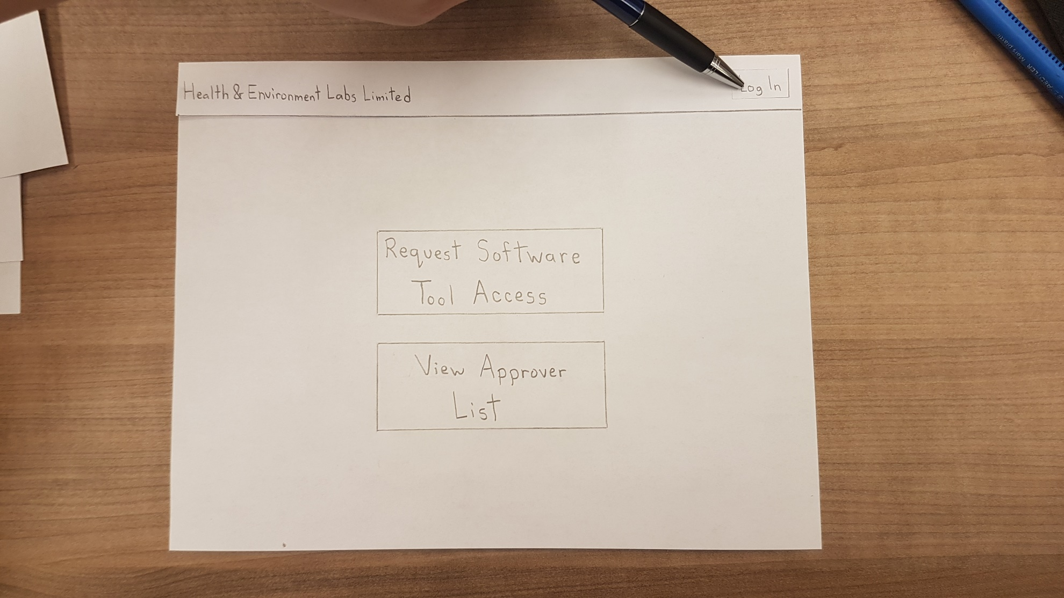

Slide 25
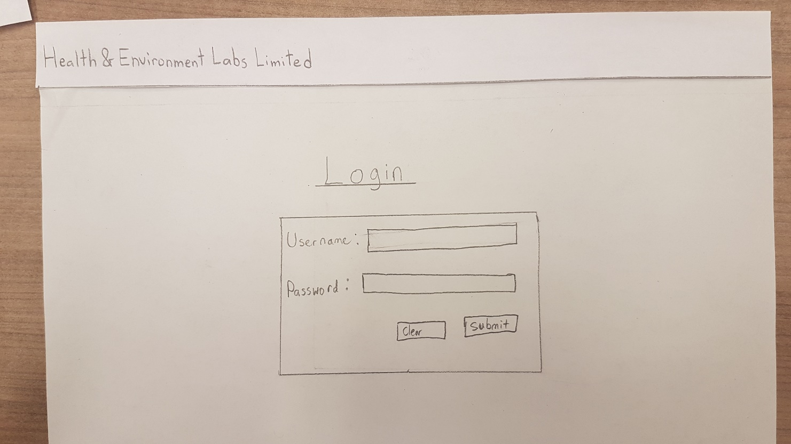

Slide 26
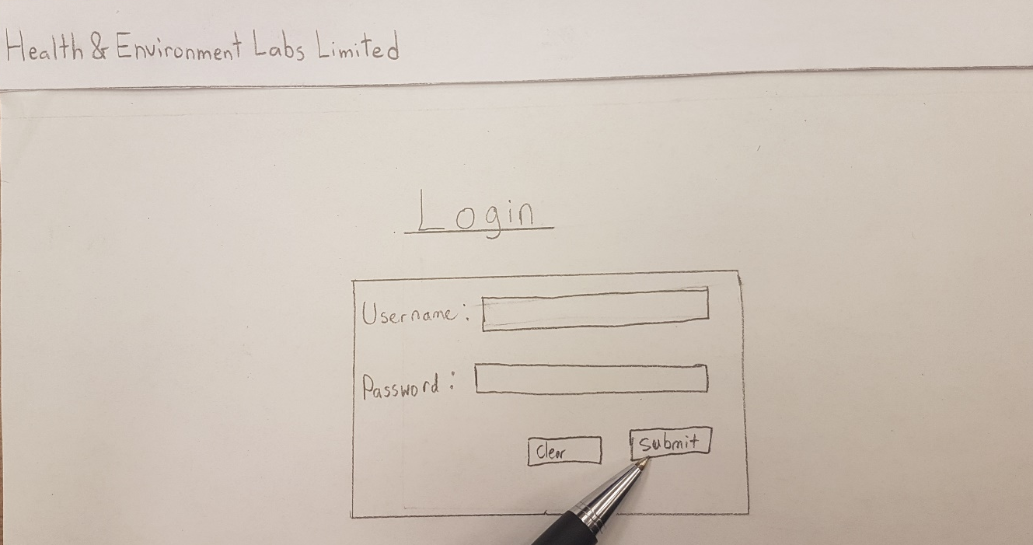

Slide 27
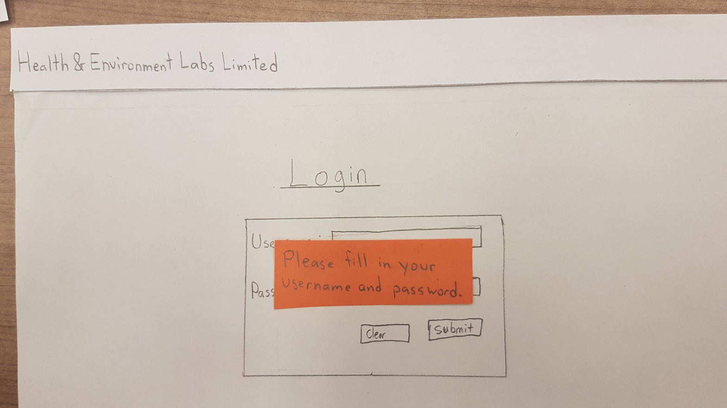

Slide 28
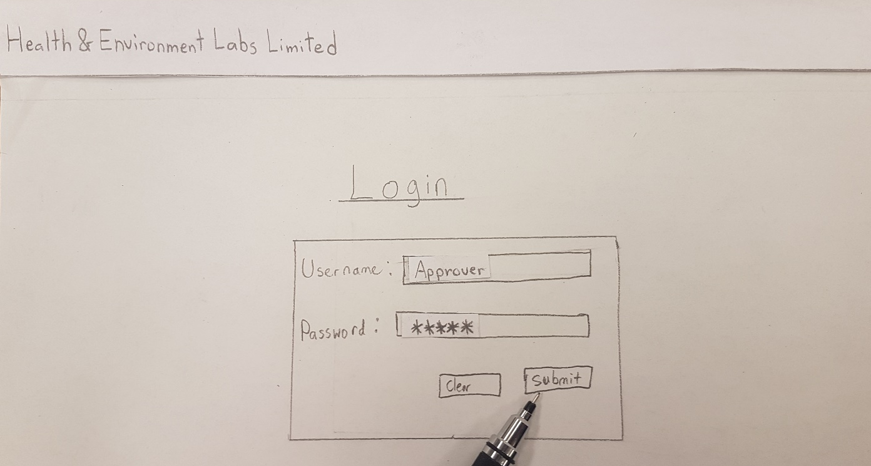

Slide 29
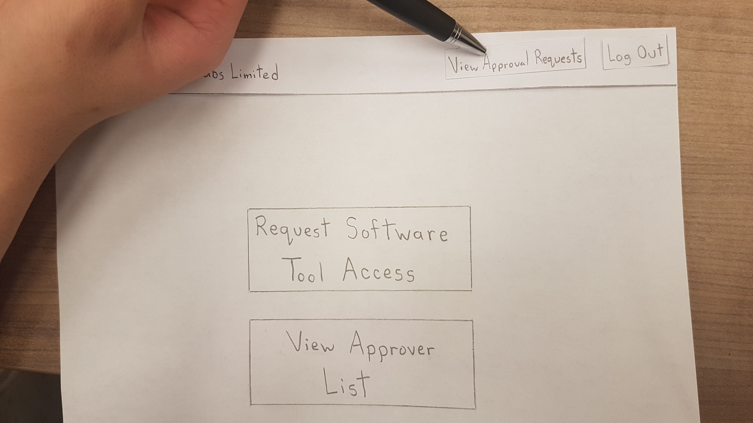

Slide 30
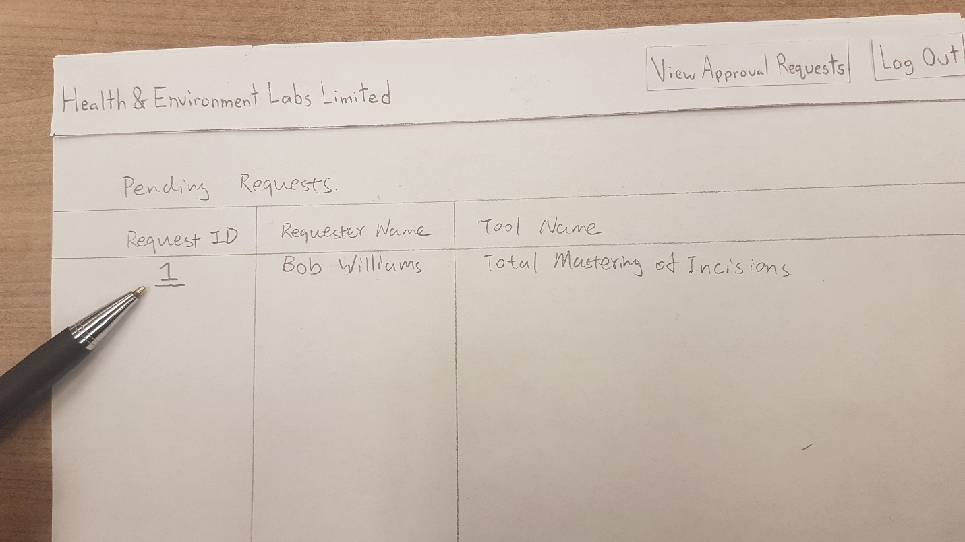

Slide 31
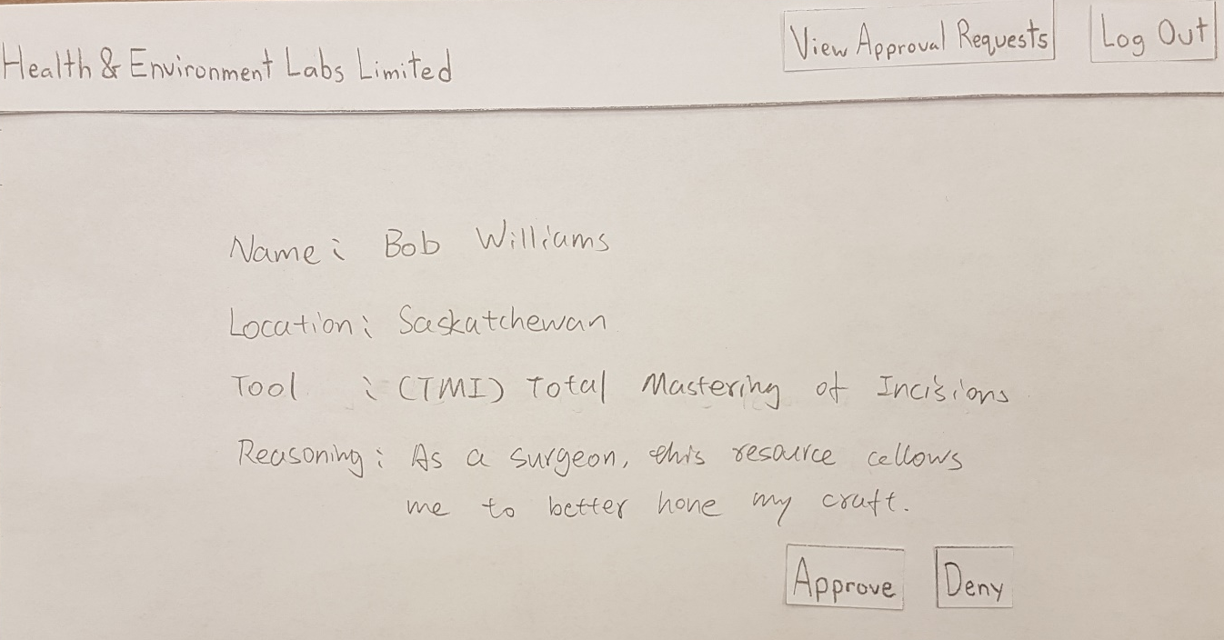

Slide 32
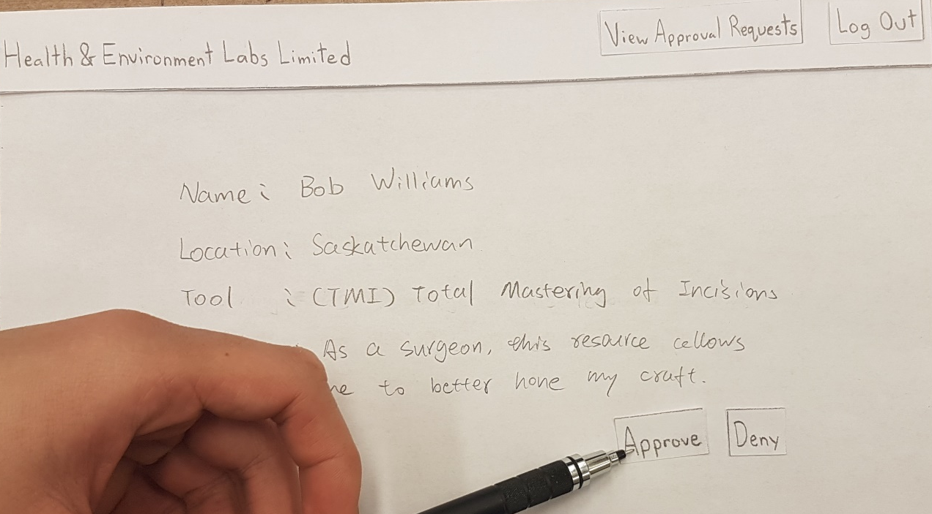

Slide 33
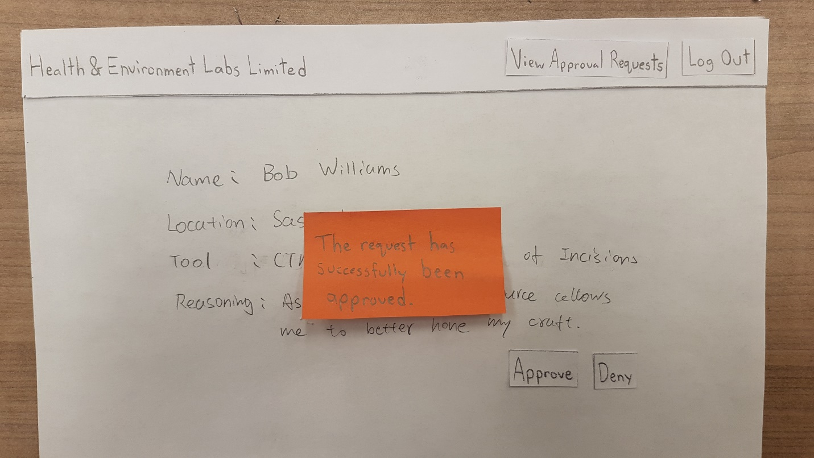

Slide 34
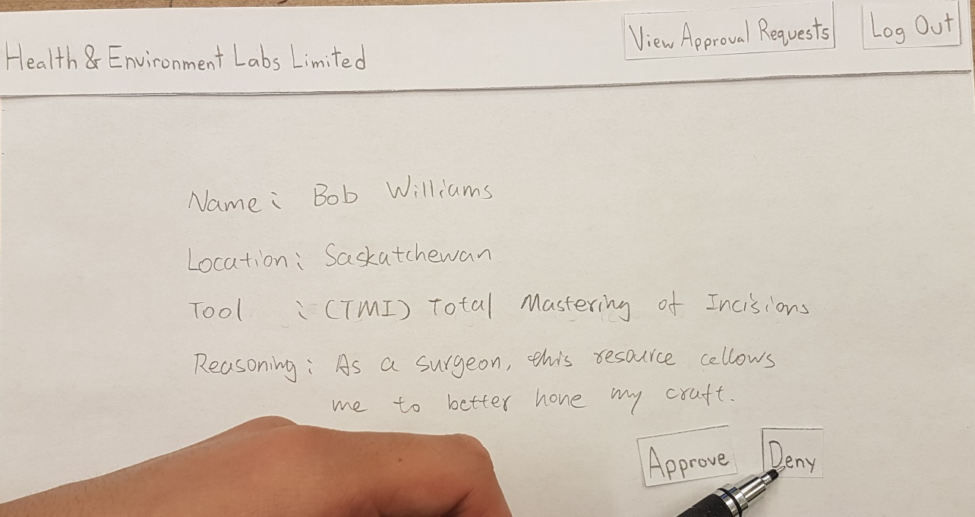

Slide 35
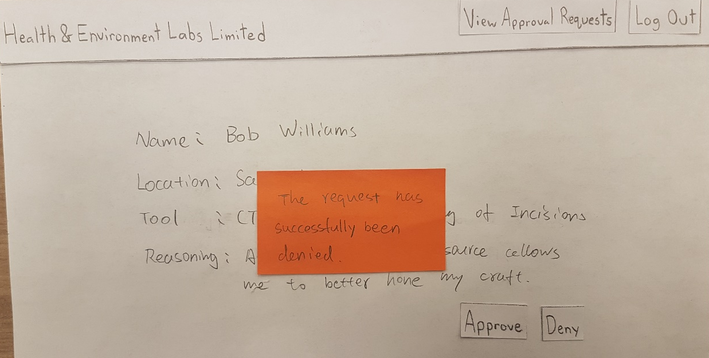

Slide 36
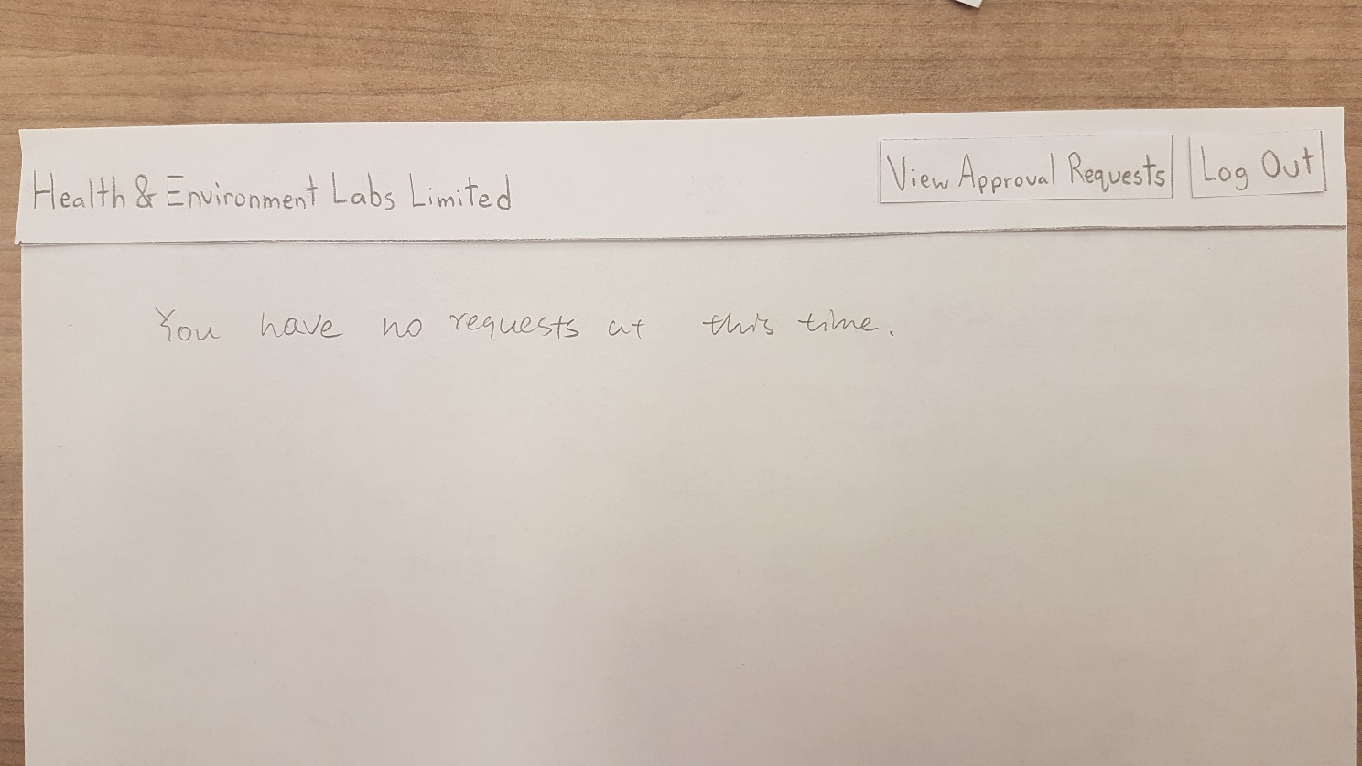

Slide 37
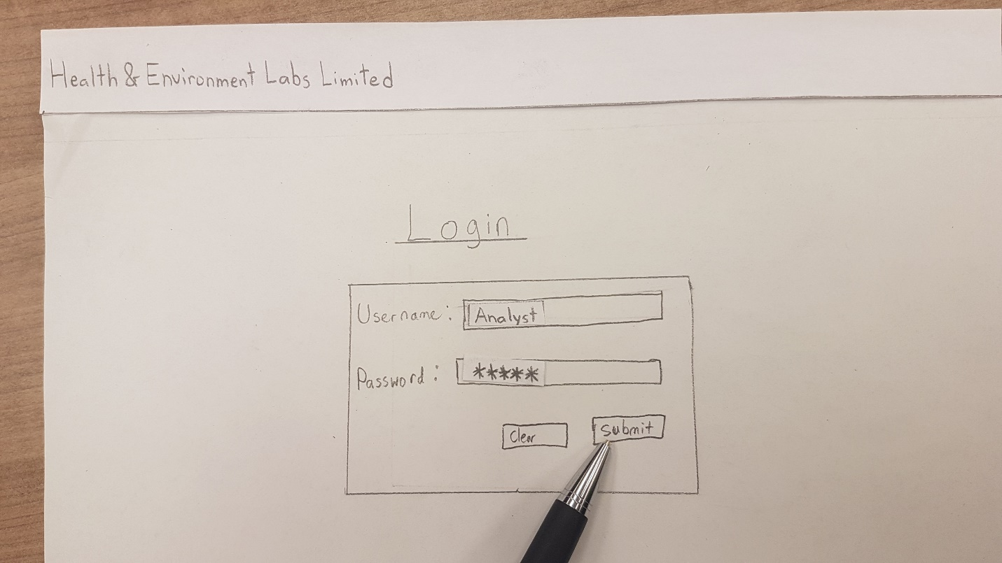

Slide 38
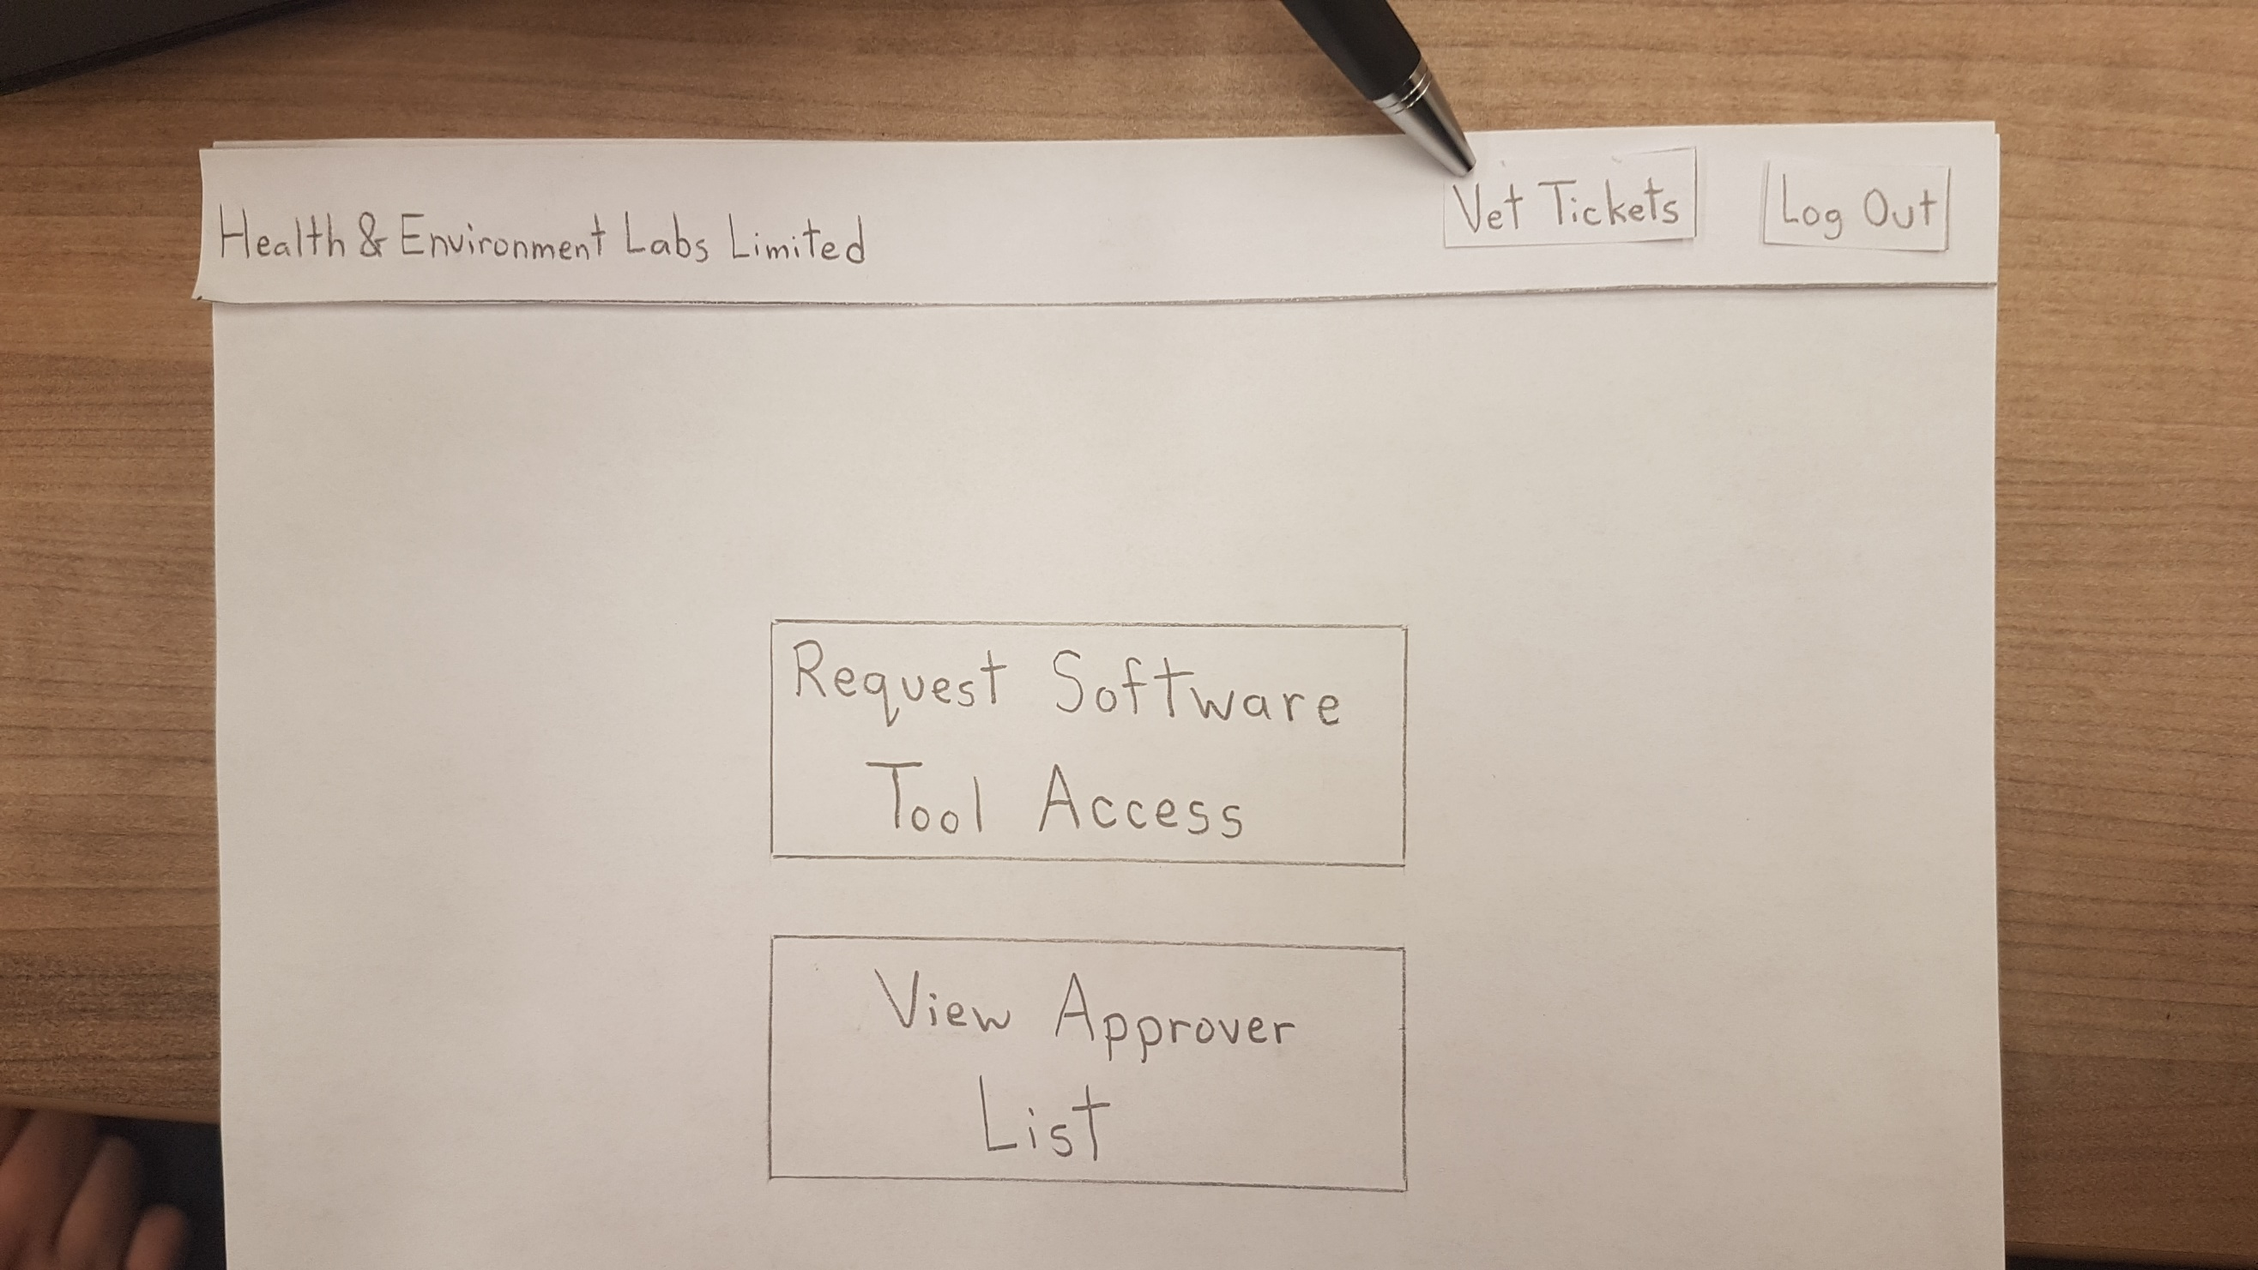

Slide 39
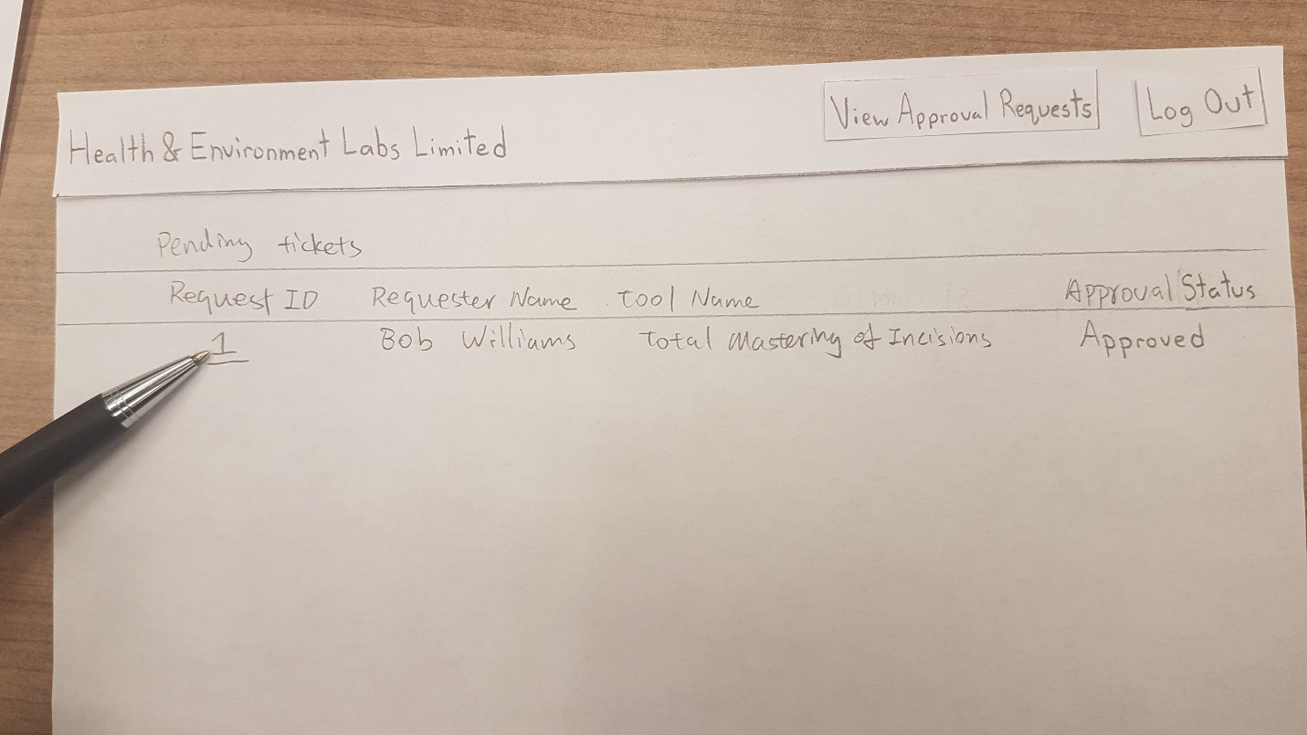

Slide 40
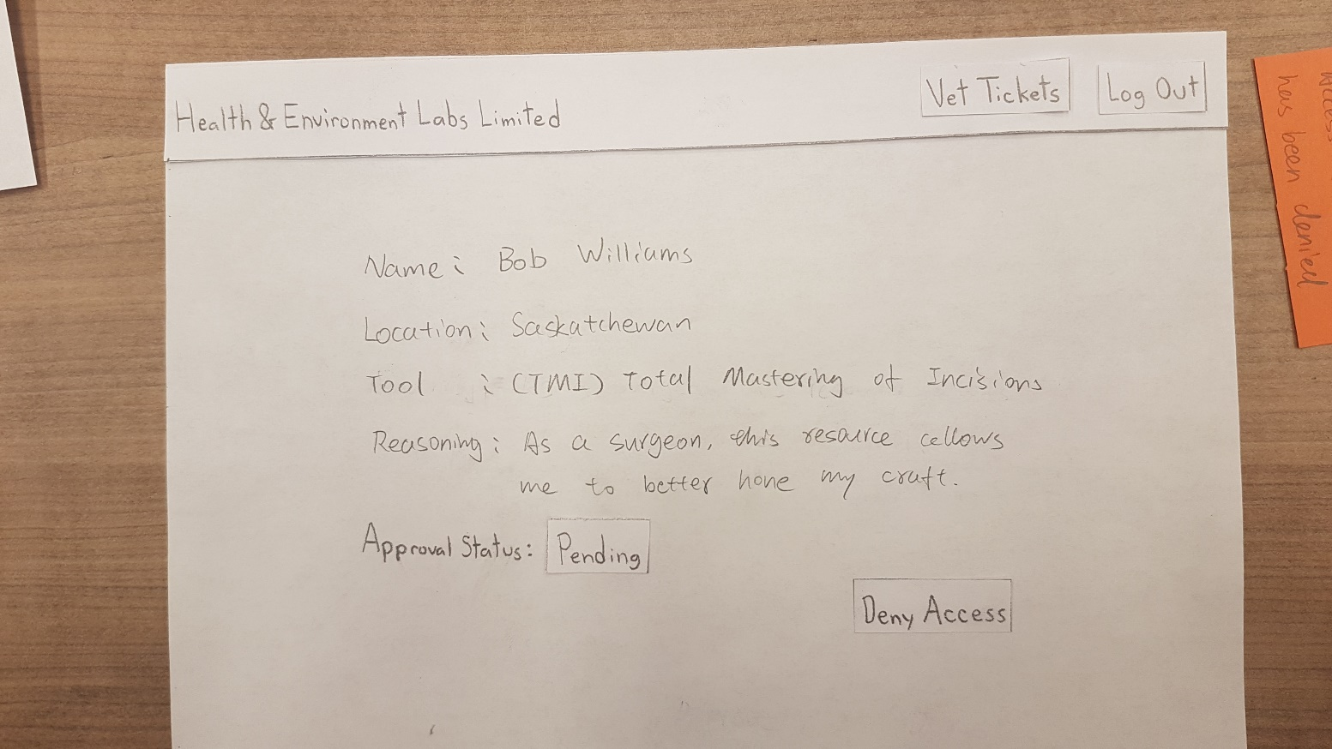

Slide 41
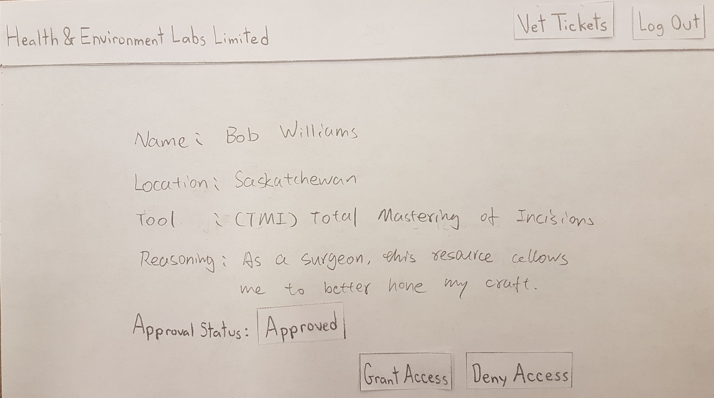

Slide 42
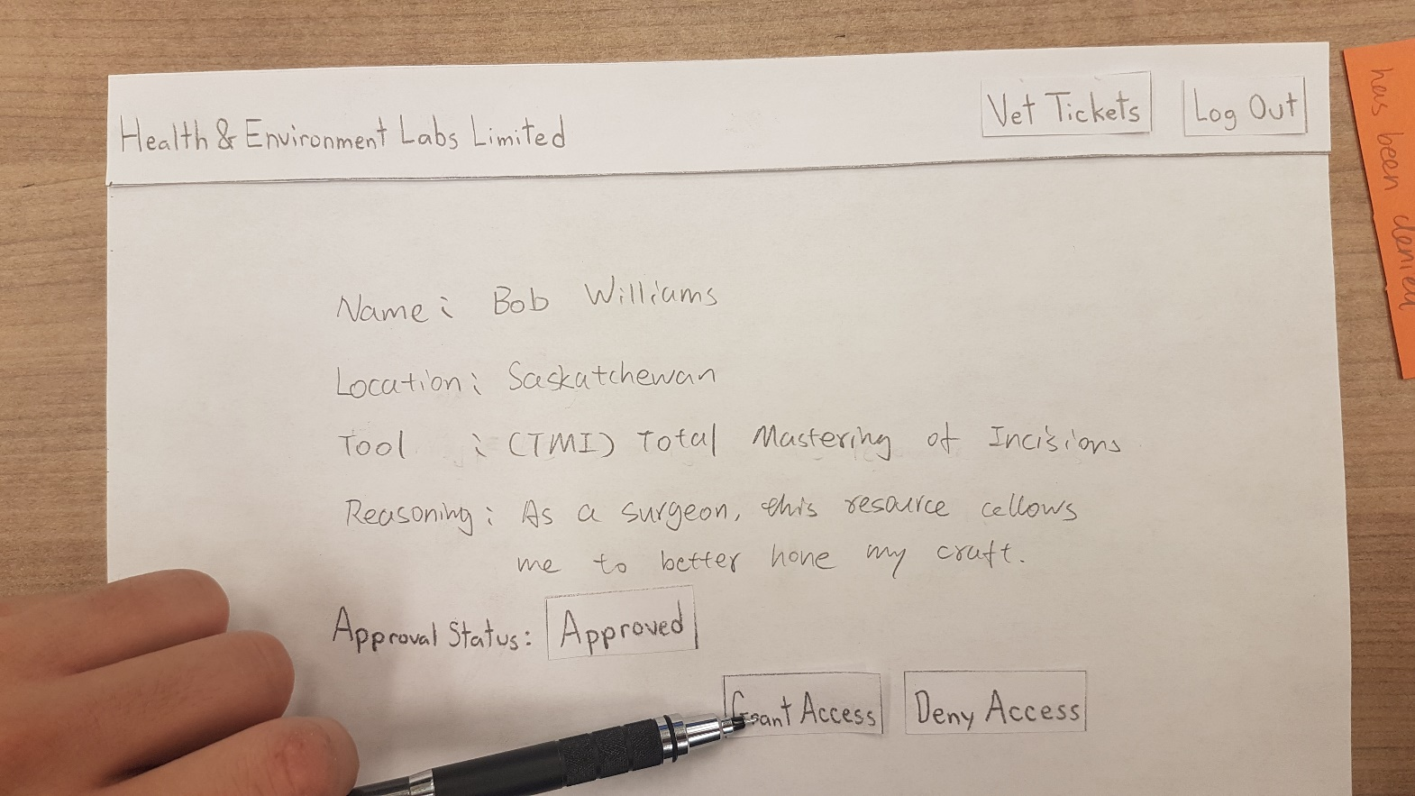

Slide 43
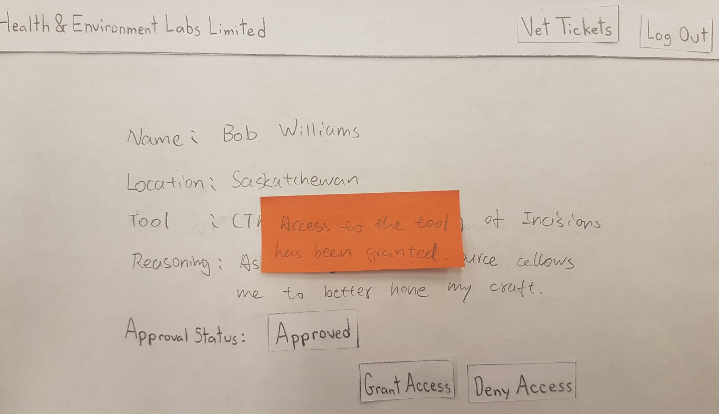

Slide 44
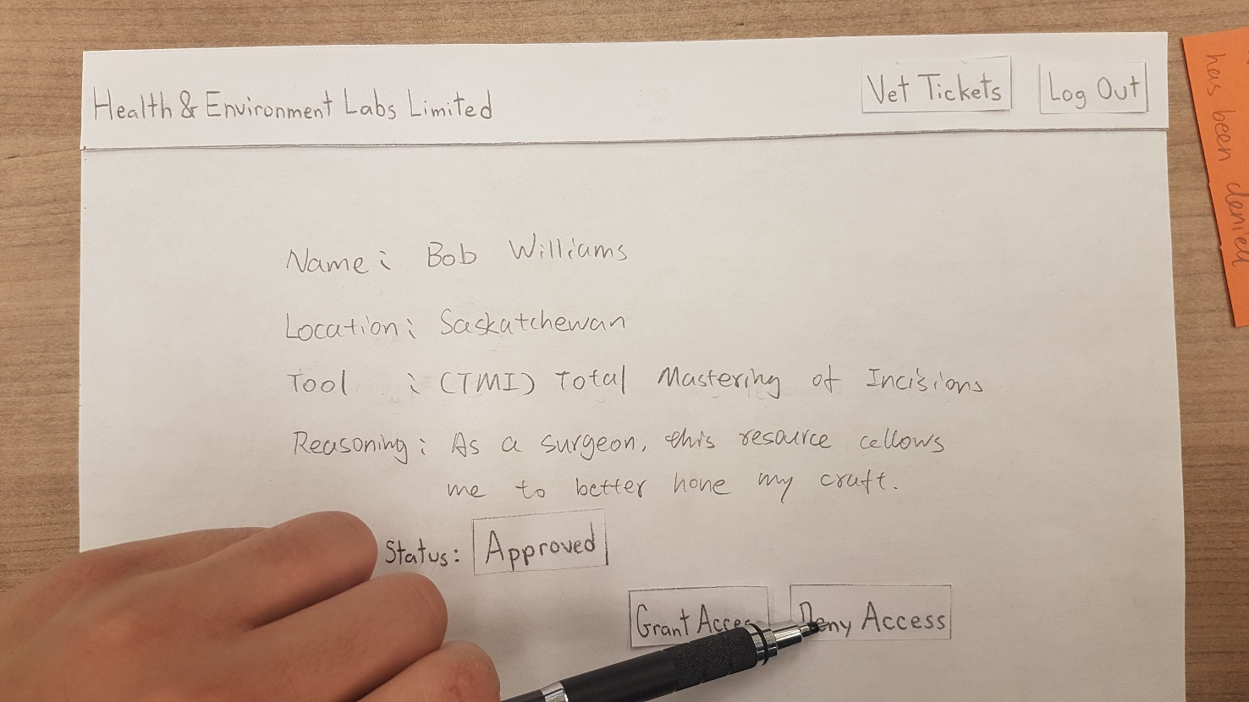

Slide 45
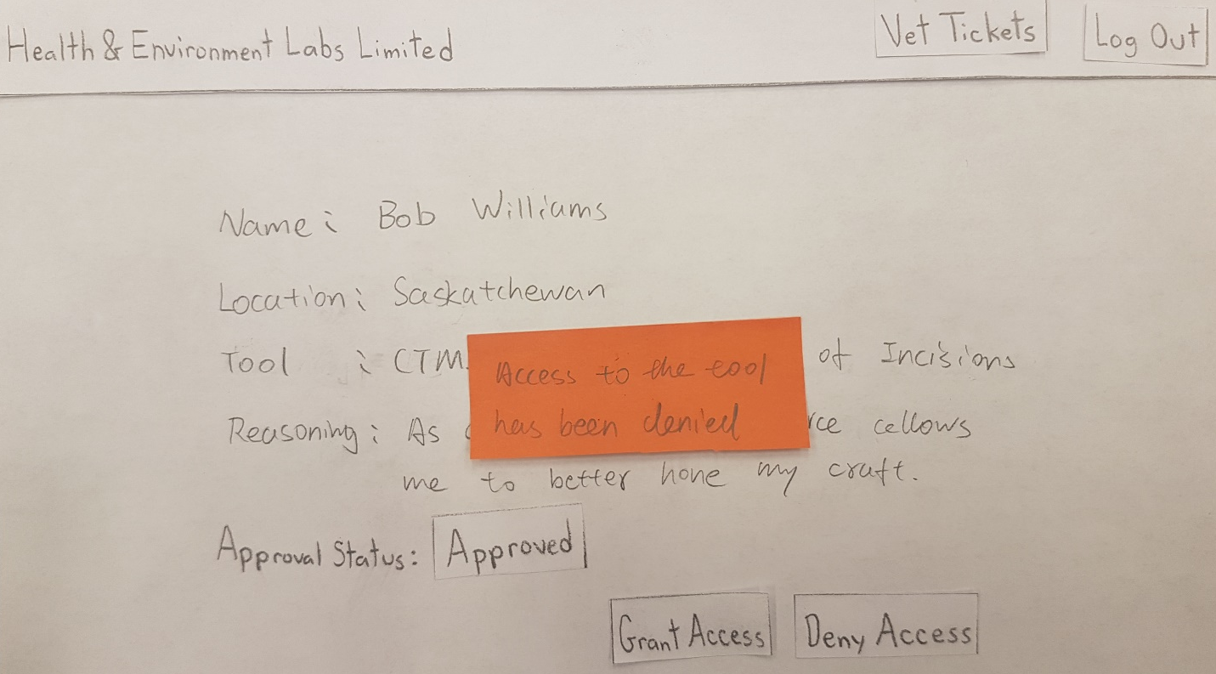

Slide 46
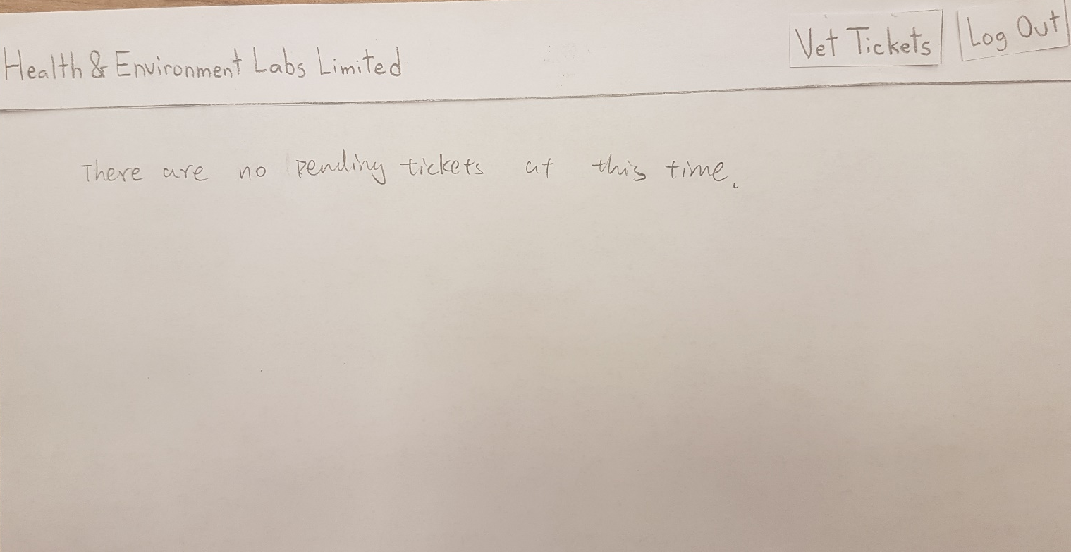

Slide 47
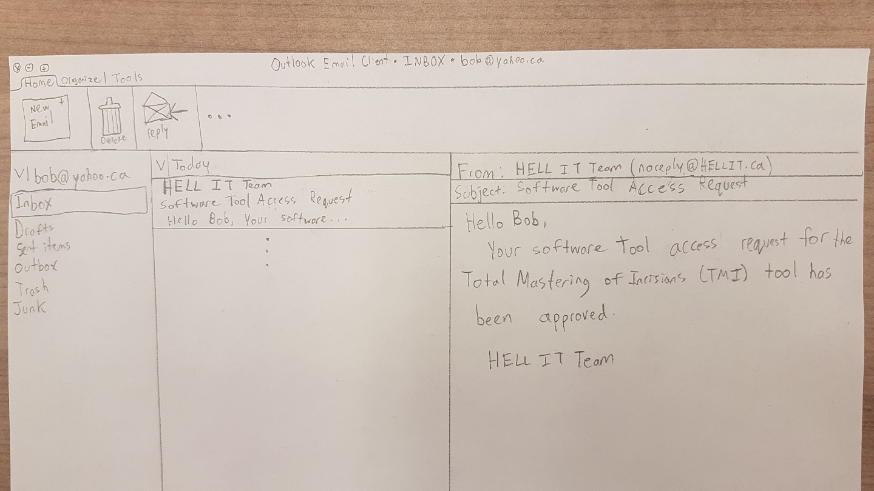

Slide 48
Changes
Have your plans changed since your group’s initial conception and project evolution?
We realized that the approvers and analysts will need to log into the software to perform their tasks. However, the requesting user does not need this capability for the Minimum Viable Product.
Although not necessary for the system to function, we decided to make the approver list publicly available due to the ease of doing so with our chosen MySQL database implementation.

Slide 49
Group Reflection
How did you feel about this milestone? What did you like about it? What did you dislike?
We liked how mapping out the interface provides us with a clear goal to aim towards during implementation. We disliked keeping track of all the components and editing over 40 pictures.
What did you learn about yourself as you collaborated and worked through this milestone?
We realized that visualization of the interface prior to actual implementation is extremely valuable for cementing our vision for the project. We also noted that group discussion early on in the design phase vastly improves the quality of the design.
How will you use what you have learned going forward?
In this project, we will use the lo-fidelity prototype to guide the actual implementation of our project. In our future careers, we can use this tool to map out an interface with minimal use of resources to obtain feedback from the client before further work is done.
What “stuff & things” related to this milestone would you want help with?
Initially, it was a bit difficult to determine what kind of database system to implement.

Slide 50
Questions?

